Slide 1
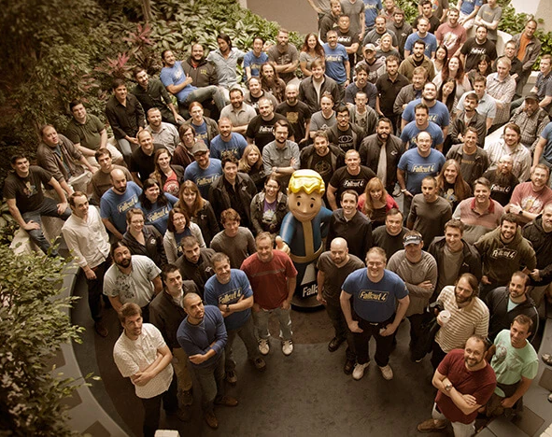
BSc Hons Computer Games Design and Development GDV4000 Introduction to Games Industry Practice
An Overview of the Interactive Entertainment Industry
(aka. The Video Games Industry)
The Fallout 4 Dev Team – Bethesda Softworks

Slide 2
What we’ll be covering -
By the Numbers – Trends in the Games Industry
A Brief History of the Games Industry Part 1
Developer / Publisher Relationships
Traditional developer-publisher relationships
Indie Development
Funding
Marketing
Marketing avenues
Production planning around Marketing
Game life-cycle
Analytics
IP, Social, and Ethical Issues Part 1 – Intellectual Property

Slide 3
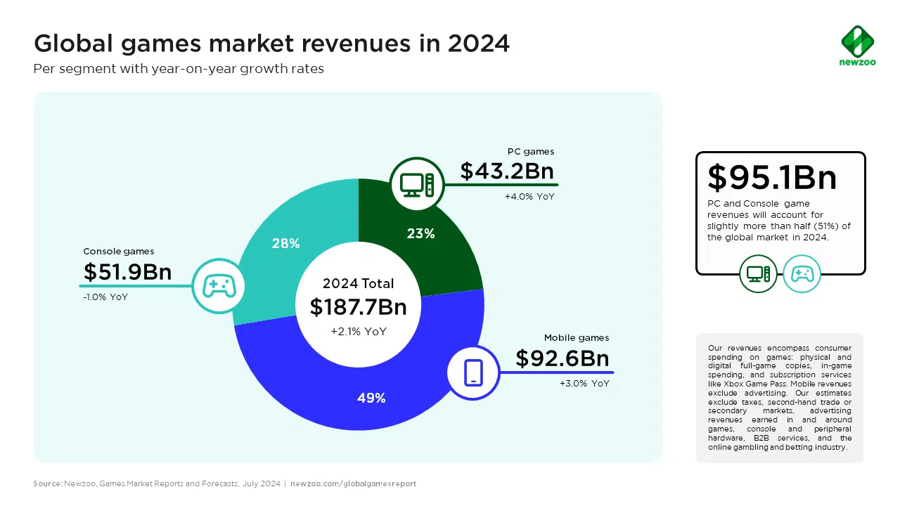
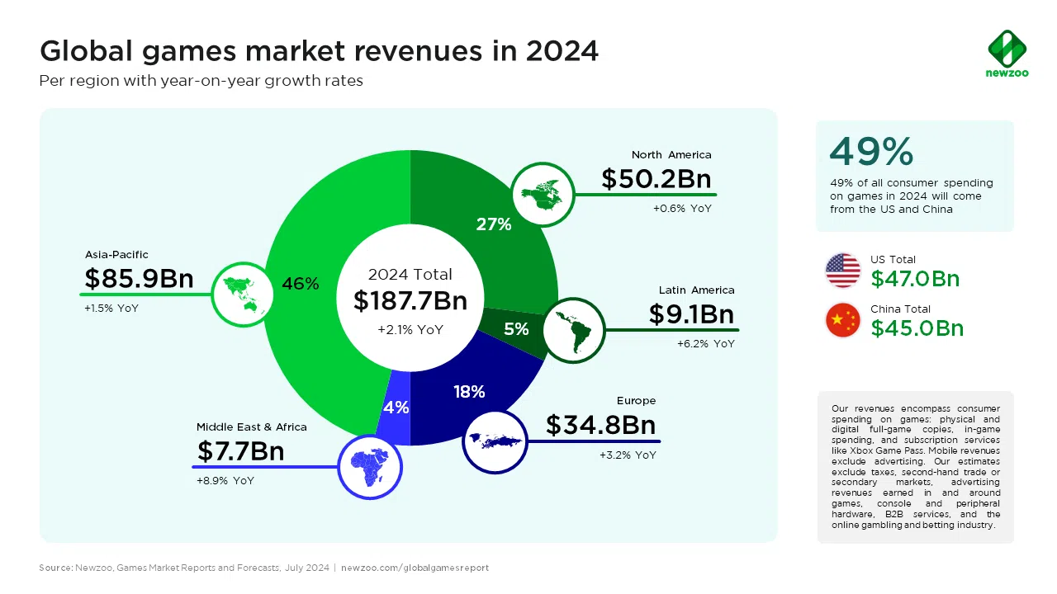
Trends in the Games Industry
Some context – When this module first ran in 2017, the Games Industry was worth over 100Bn USD…
In 2024 that figure has increased to 187.7Bn USD, with a prediction that it will continue to increase year on year. With the release of a new Nintendo device, and Grand Theft Auto VI sometime in the next year (what a difference a year makes!); Newzoo are forecasting that the industry will be worth 213.3Bn USD by 2027.
Source - https://newzoo.com/resources/blog/global-games-market-revenue-estimates-and-forecasts-in-2024

Slide 4
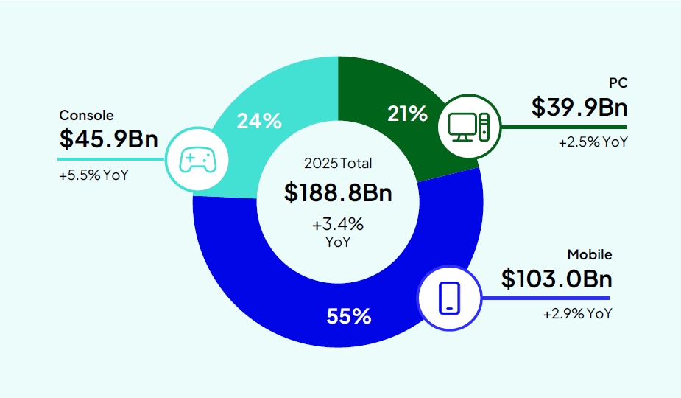
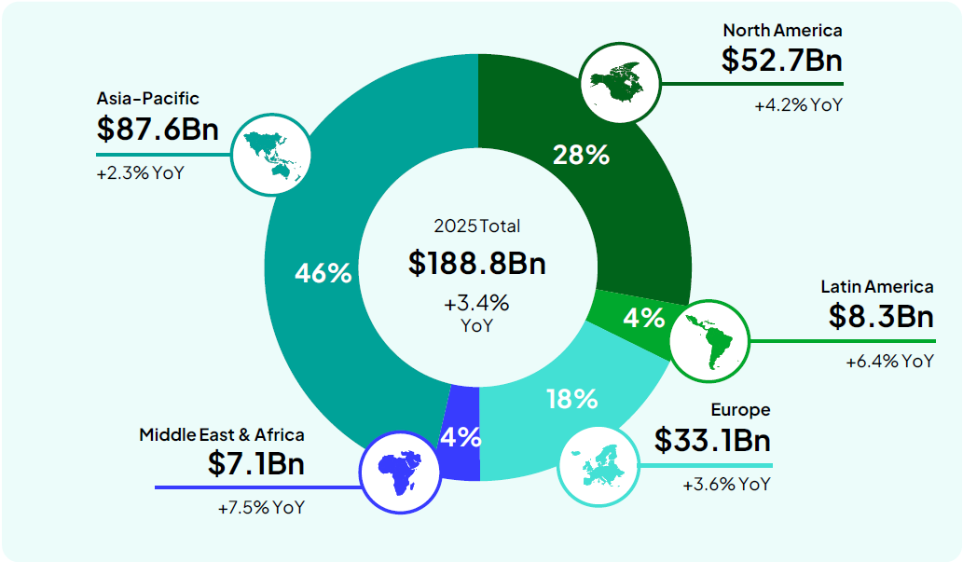
Trends in the Games Industry
So how are things looking now?
In 2025 we saw an increase to 188.8Bn USD, aided by the release of the Nintendo Switch 2 (particularly in Eastern Asia and France). An improvement in the Mobile market, compared to PC and Console, which were still being supported by legacy titles The Sims 4 and Counter-Strike 2. An expanding Steam user-base in China is expected to boost the PC market (Newzoo, 2025).
The revenue increased from last year everywhere except from Europe and Latin America.
The Newzoo report does not mention GTA VI, but if released this year, that could see a massive boost to the overall revenue and the console market.
Source – Newzoo (2025)

Slide 5
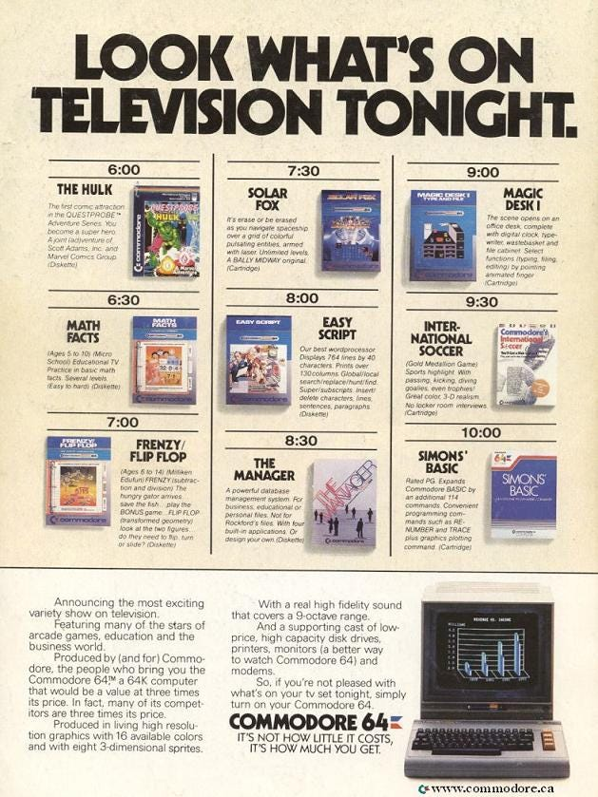
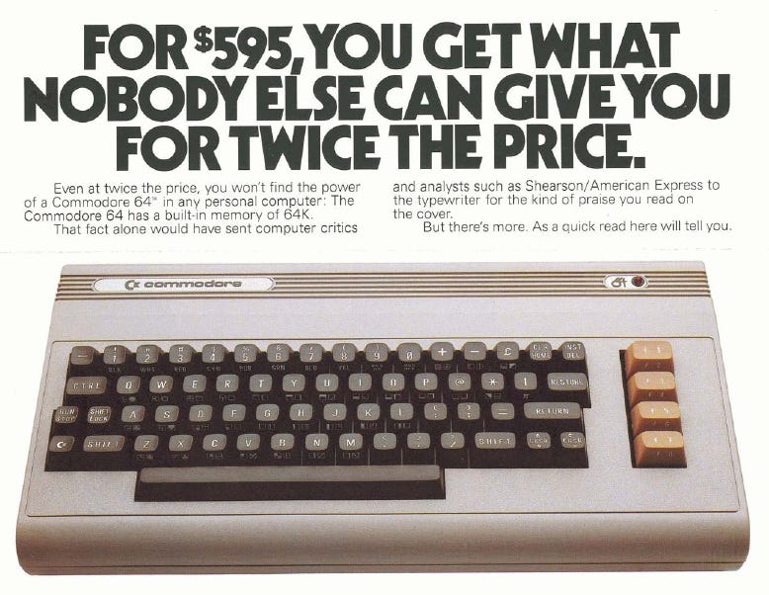
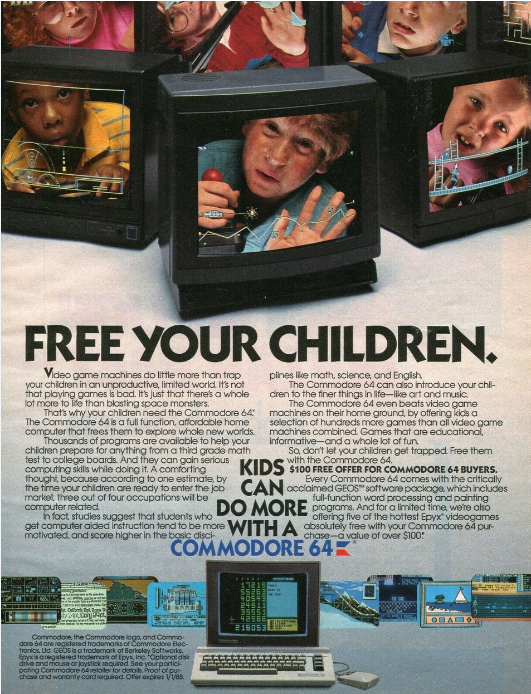
Trends in the Games Industry
This may be a little surprising, given that the industry has seen studio closures and lay-offs since the end of the pandemic… But we have been here before.
In December 1982, the ‘Big Shake-Out’ saw Atari, Mattel, Coleco, Sega and others lay off staff, and smaller companies closed completely (Stilphen, N.D.). By 1984, Atari was under new management and had switched from software to home computers, with the Atari ST 520FM appearing a year later.
Some contributing factors –
The creation of Activision in 1979, co-founded by programmers who had left Atari following a dispute, as at the time Atari exercised a policy of not crediting the developers on games or paying royalties on sales. Atari attempted to block sales of Activision games, but they lost their legal battle in 1982.
Flooding the market – The formation of Activision and Atari’s unsuccessful bid to stop them opened the market up for third-party development for the first time and caused a flood of games of variable quality.
The launch of the ZX Spectrum and the Commodore 64 in Europe. They were cheaper than the consoles and Commodore ran very effective marketing to persuade parents that their child would benefit much more from a home computer than a games console.

Slide 6

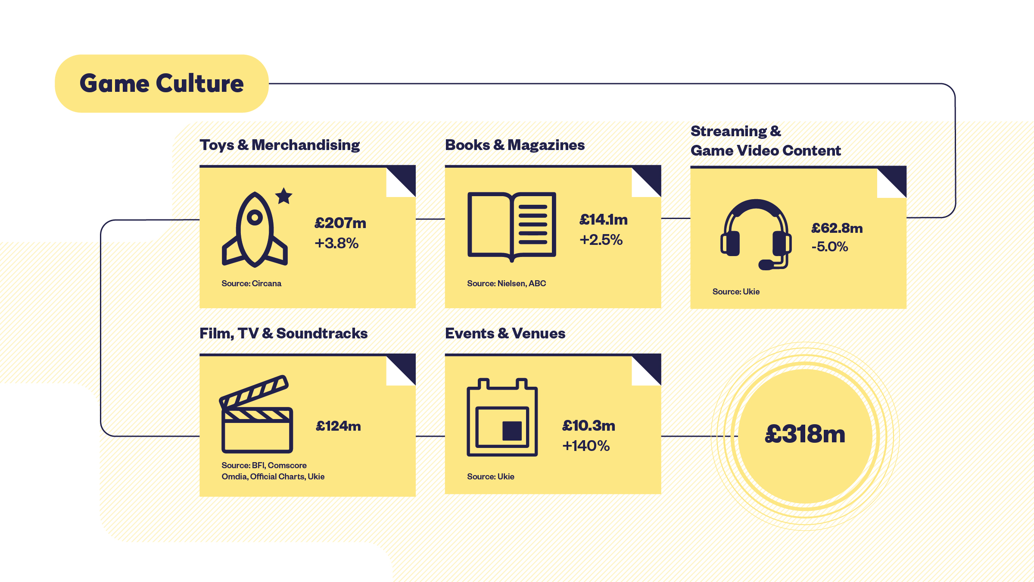
Trends in the Games Industry
In the UK there are 2,230 active games companies
TIGA have reported that 73% of UK games studios were looking to grow in 2024 (McEvoy, 2024)
In their 2023 Video Game Industry Valuation, UKIE (Ukie, 2024) for the first time have started to track digital & TV based on video game IPs, including toys and soundtracks
https://gamesmap.uk/#/map

Slide 7

Trends in the Games Industry
2024
2025
A side-by-side comparison from 2024 to 2025 shows that, in some areas, there have been closures, but in others there are signs of growth.
https://gamesmap.uk/#/map

Slide 8
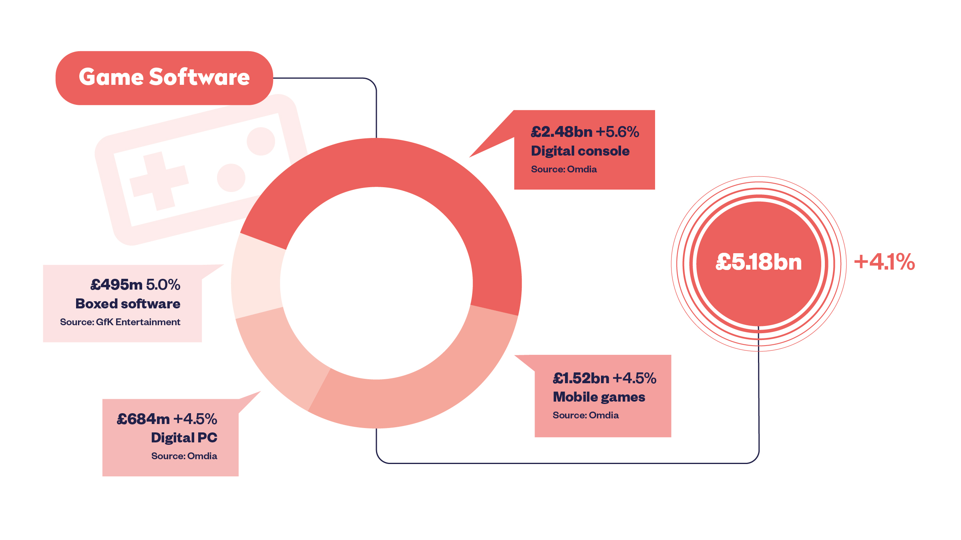
Trends in the Games Industry
2023 UK Software Sales
£4.33bn
Source: http://ukie.org.uk/research#fact_sheet
Source: https://ukie.org.uk/news/2024/04/2023VideoGameIndustryValuation
Despite the turbulence in the industry, over a seven-year period we can see a growth in the PC, Console, and Mobile games markets. Boxed software sales have tailed off to £495m, despite a boost during 2020 to £646m (Clement, 2024).

Slide 9

2. A Brief History of the Games Industry Part 1
• The Games Industry has undergone a number of key developments over the last 40-50 years. Key areas of the industry’s history are…
The development of the Arcade Machine
The emergence of the home video game market (consoles then home computing)
The development of console and PC technology
The development of mobile gaming, handheld gaming.
Virtual Reality (VR) and Augmented Reality (AR)

Slide 10

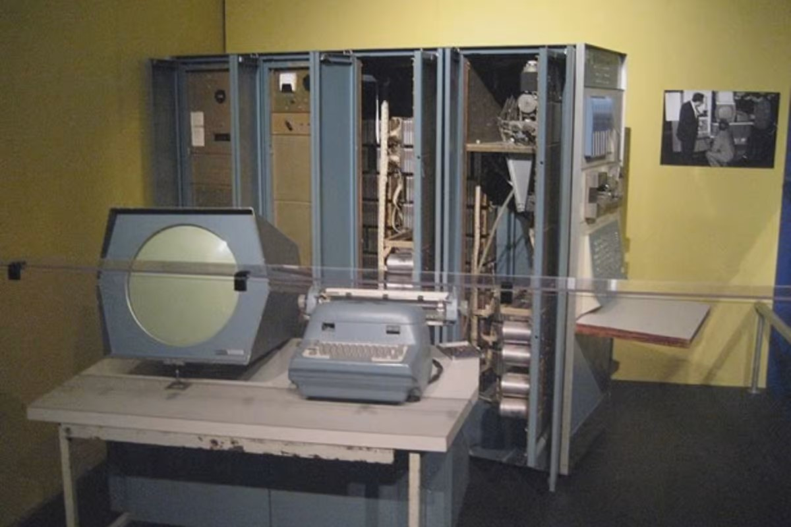
2. A Brief History of the Games Industry Part 1
Where did it start?
Some early innovations…
Pre 1950.
In 1947, Thomas T. Goldsmith Jr., and Estle Ray Mann filed the patent for the ‘Cathode-ray Tube Amusement Device’. It was granted in December 1948 and became the first electronic game. The player could fire missiles on the screen at targets with an electron gun. The high cost of production meant that the device never went beyond the prototype stage (Dalakov, N.D).
Thomas Toliver Goldsmith Jr. 1910 - 2009

Slide 11


2. A Brief History of the Games Industry Part 1
1950s – 1960s.
In 1962, the first officially recognised video game ‘Spacewar!’ was developed for the PDP-1 system. The idea came from Steve ‘Slug’ Russell as an idea for a spaceship trainer. It was developed alongside Russell by Martin Graetz and Wayne Wiitanen from Harvard and MIT.
Click here to watch a brief interview with Steve Russell about the inspiration behind and creation of ‘Spacewar!’

Slide 12


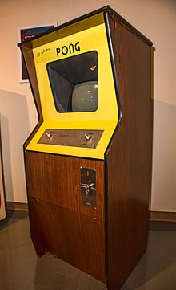
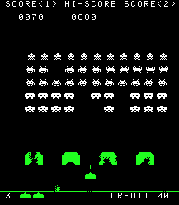
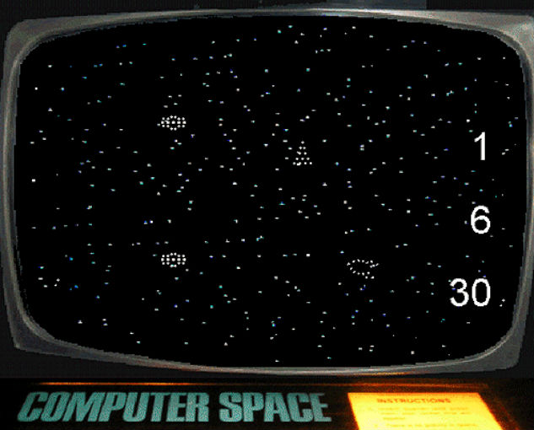
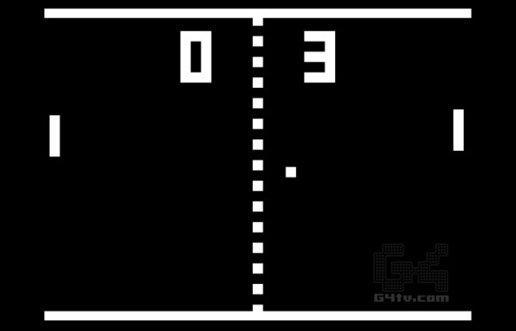

2. A Brief History of the Games Industry Part 1
1970s
© Copyright Nutting Associates
© Copyright Atari
Space Race, Tank, Jet Fighter, Breakout… CRASH!
© Copyright Taito
1971
Computer Space released (first arcade cabinet). Created by Nolan Bushnell. It released with a lot of publicity (and a cameo in the film ‘Soylent Green’) but didn’t generate the sales expected. Bushnell considered the game too complex for casual bar-goers, although it has been said that the failure was due to other factors (Wardrip-Fruin, 2021).
1972
Pong released (first successful arcade cabinet). Created by Nolan Bushnell and Al Alcorn. Pong had its debut in Sunnyvale, California and was so popular that the machine broke down after being filled with too many quarters.
It was much simpler than Computer Space, featuring only two on-screen paddles and a ‘ball’. No instructions required!
Its massive success is considered to have helped launch the video game industry (Britannica, 2024)
1978
Space Invaders released by Taito and created by Tomohiro Nishikado.
Nishikado spent months with a Pong arcade cabinet, dissecting it to understand how it worked.
Space Invaders collected $2bn in quarters in its lifetime
Yes, there was a crash in the late 70’s too! Atari had a massive success with Pong, but they failed to copyright the IP, which led to a lot of Pong-clones flooding the home console market, which led to the price of the consoles dropping and companies going bust as a result.
1972
Nolan Bushnell and Ted Dabney form ATARI.

Slide 13

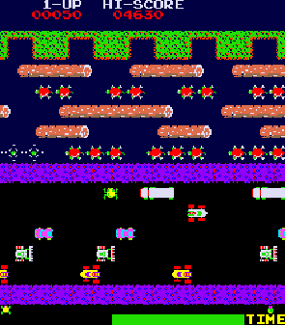
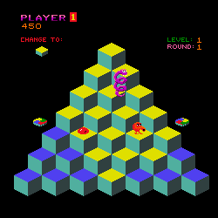

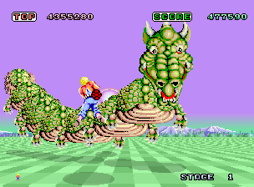


2. A Brief History of the Games Industry Part 1
1980s – Notable Arcade Games.
© Copyright Namco
© Copyright Nintendo
© Copyright Konami
© Copyright Gottlieb
© Copyright SEGA, ReignDesign
© Copyright SEGA
© Copyright Irem
1980
PacMan. Created by Toru Iwatani and a team of nine developers, PacMan started life in Japan as Puck-Man, but was changed for the North American release.
Considered to be one of the greatest games of all time.
1981
Donkey Kong. Created by Shigeru Miyamoto, Donkey Kong is the first appearance of Mario (here called ‘Jump Man’).
It was designed, much like PacMan, around a very simple control system.
1981
Frogger. Created by Takahide Arima, Frogger’s objective was to navigate 5 frogs across a busy road and a river to get to one of the 5 empty homes at the top of the screen. It held the distinction of having the most ways to die!
1982
Q*Bert. Created by Warren Davis and Jeff Lee.
The design was inspired by the artwork of M.C. Escher, using isometric graphics to mimic a 3D-like effect.
When colliding with an enemy, Q*Bert would ‘swear’, using random sounds made by the sound chip.
1985
Space Harrier. Designed by Yu Suzuki. A fast-paced rail shooter. The main character was originally intended to be a fighter jet but had to be changed to a human character with a jet-pack due to technical and memory restrictions.
The arcade version came in two forms – A cabinet with an analogue flight stick, and a deluxe version with a cock-pit style motion simulator, which moves with the character.
1986
Outrun. Another classic by Yu Suzuki. Outrun is rightly considered as one of the greatest games of all time. It was the highest-grossing arcade game of 1987, and a pivotal part of the recovery of the arcade industry.
Like Space Harrier, the deluxe version had a hydraulic cabinet and also boasted a selectable soundtrack.
1987
R-Type. Japan’s highest-grossing arcade game of 1987. This was the first game to take advantage of the 16-bit M72 arcade system.
Gameplay was a little different to other shooters, as the pace was slower and more reliant on remembering enemy patterns.

Slide 14
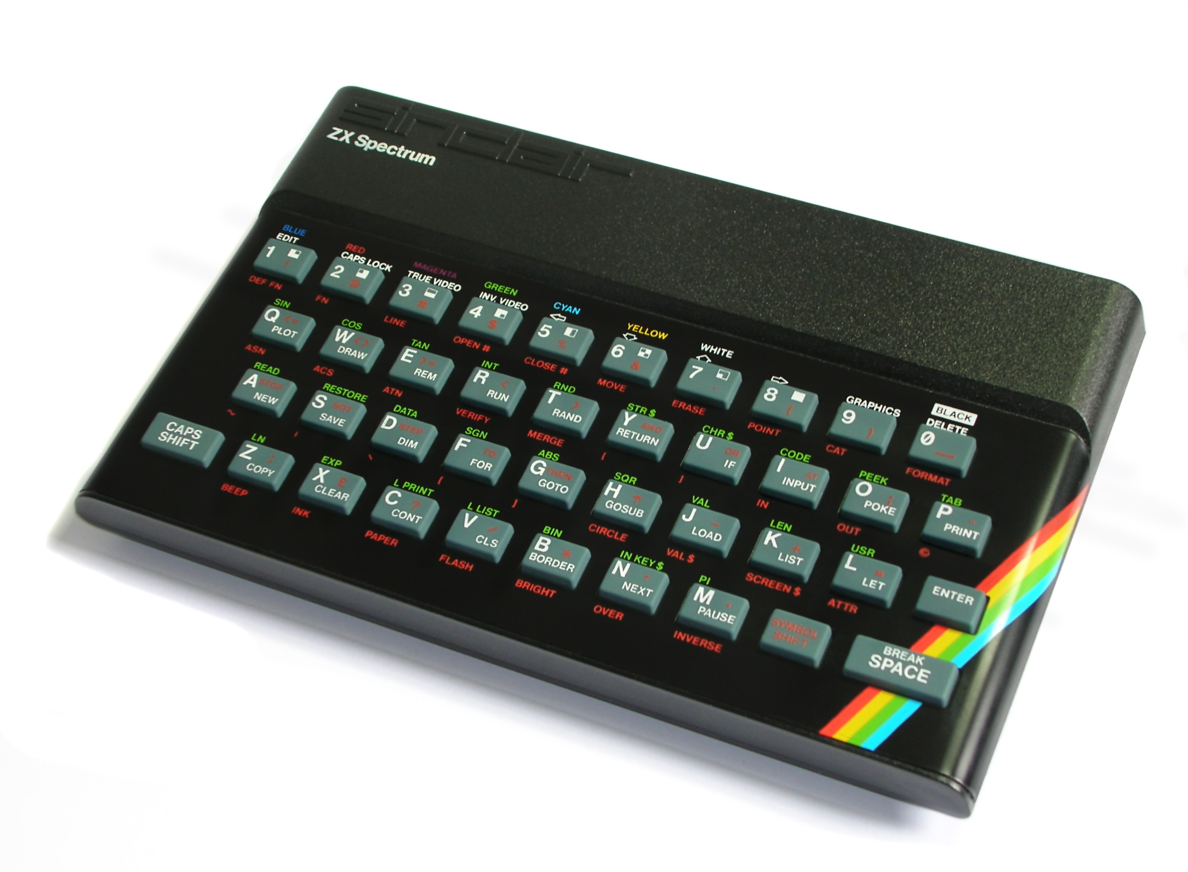
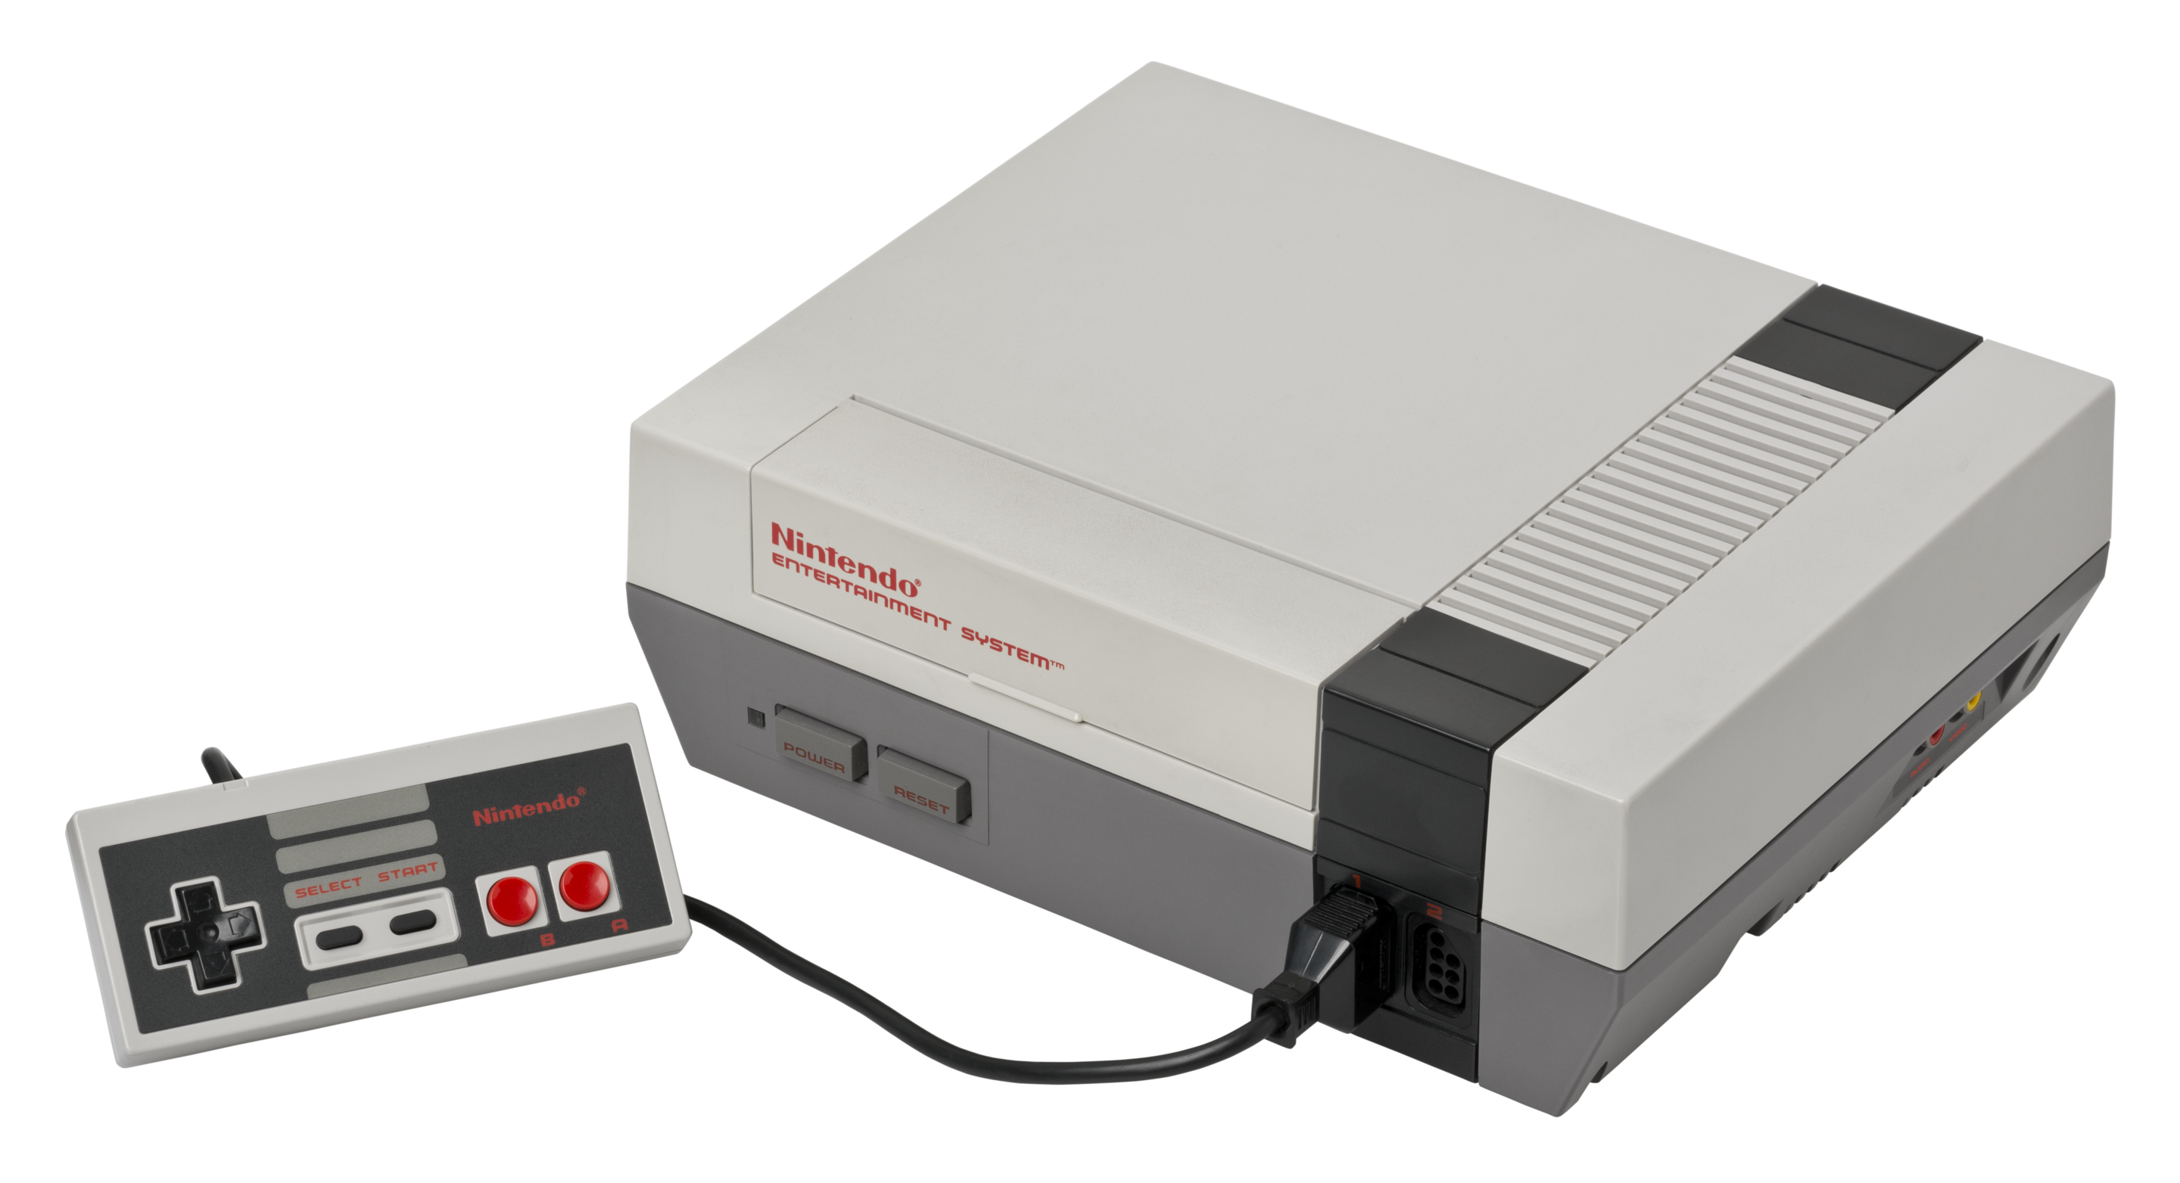
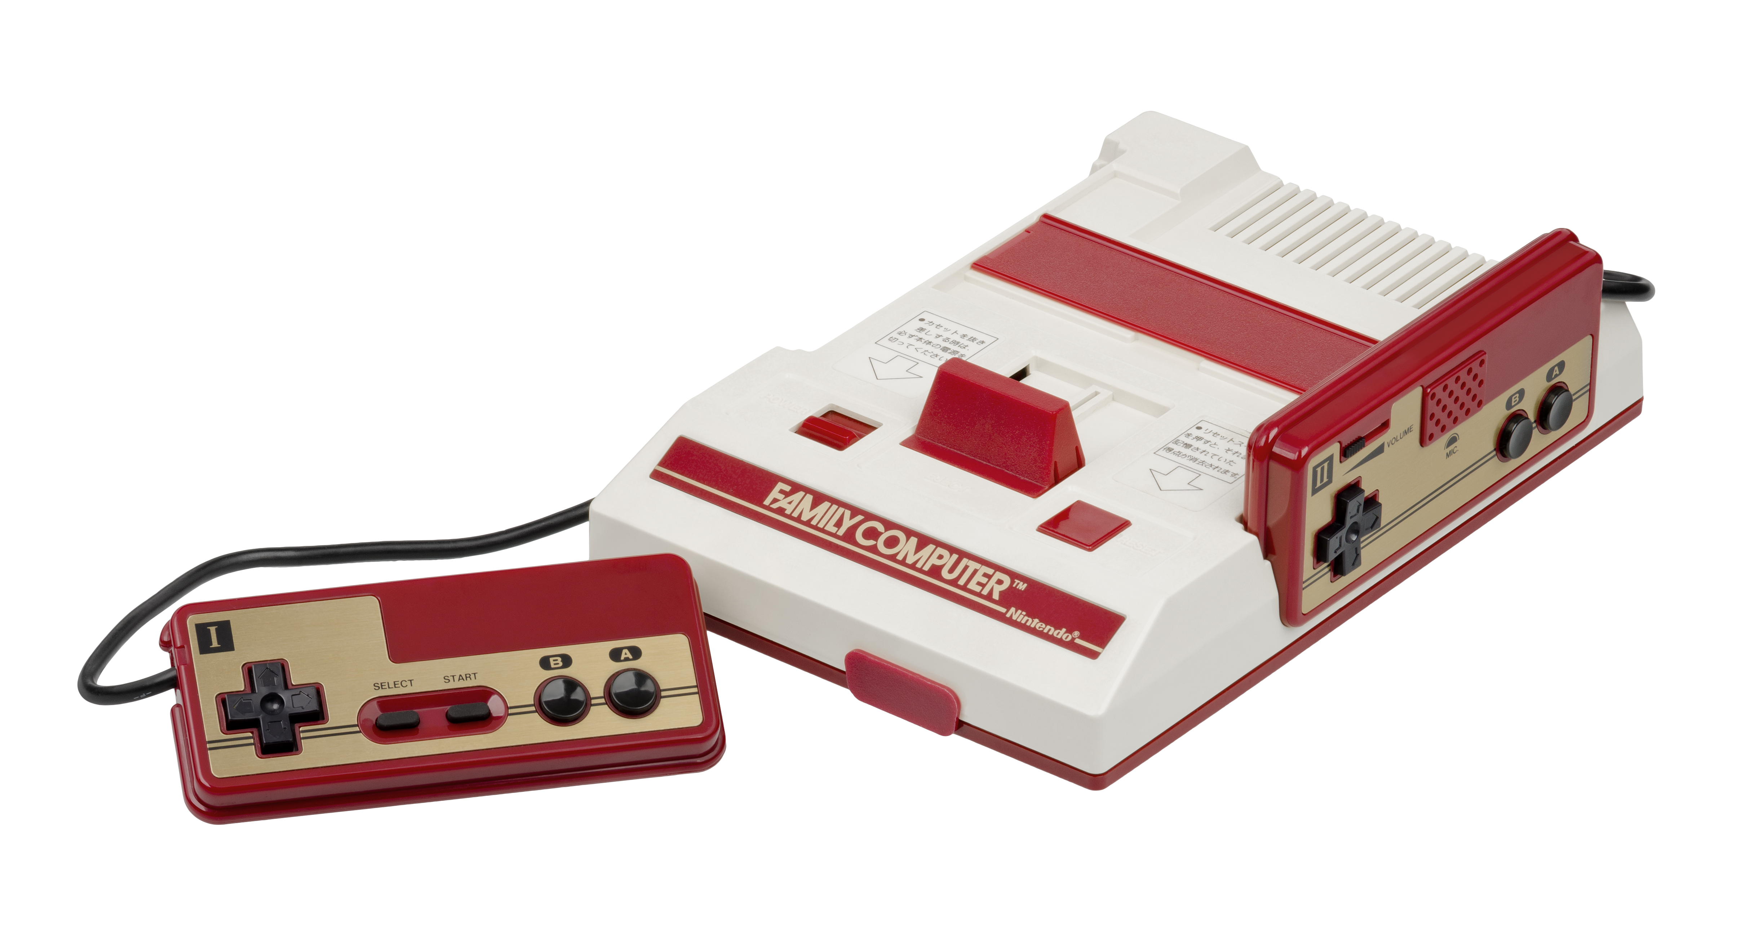
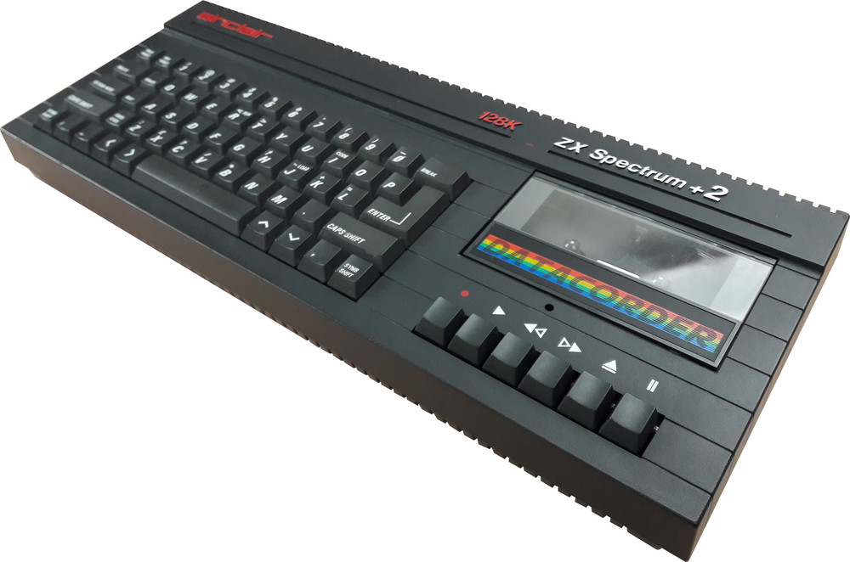
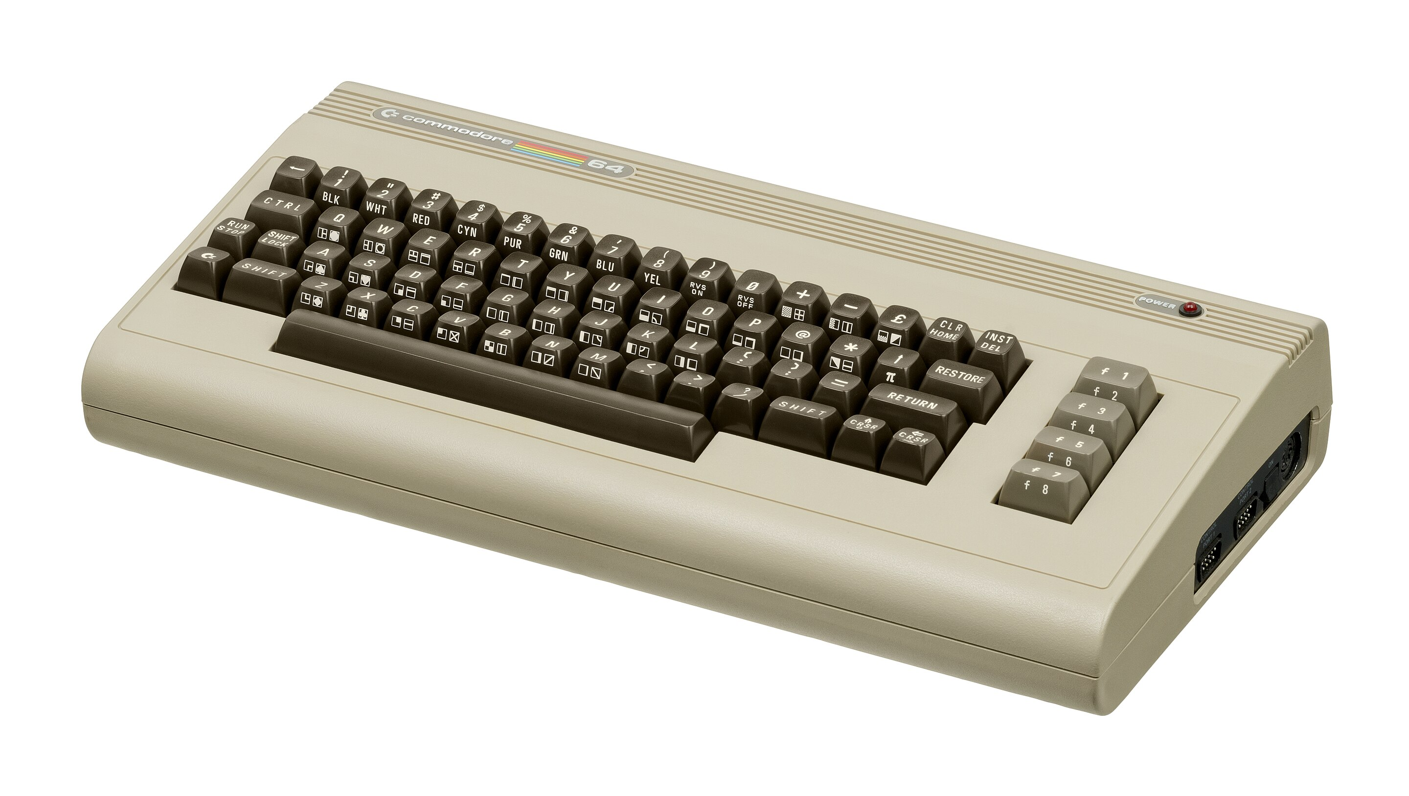
2. A Brief History of the Games Industry Part 1
Other key developments during the 1980s…
Famicom/NES (1983 US, 1986 Europe) Re-invigorated the home console market in the US
Home computing grew in popularity– particularly in the UK and Europe
During the early to mid 80s, the Sinclair ZX Spectrum and the Commodore 64 became hugely popular home computers. They are considered to be major factors in the development of the UK games industry during this period.

Slide 15
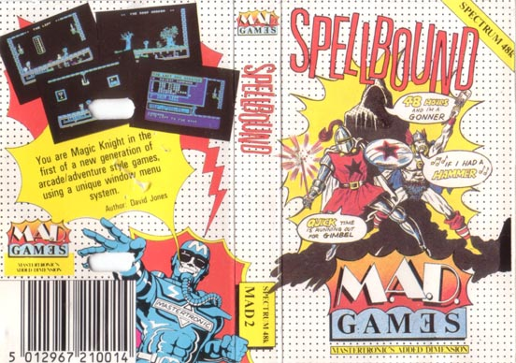



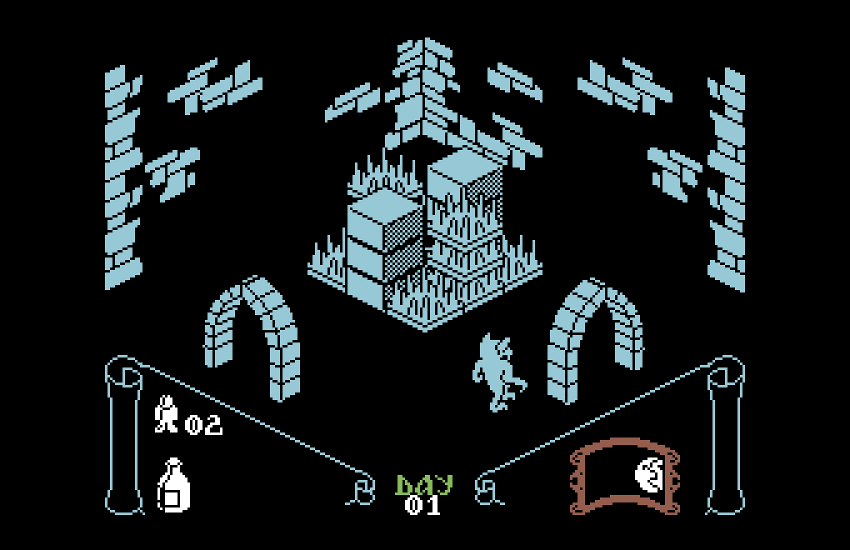
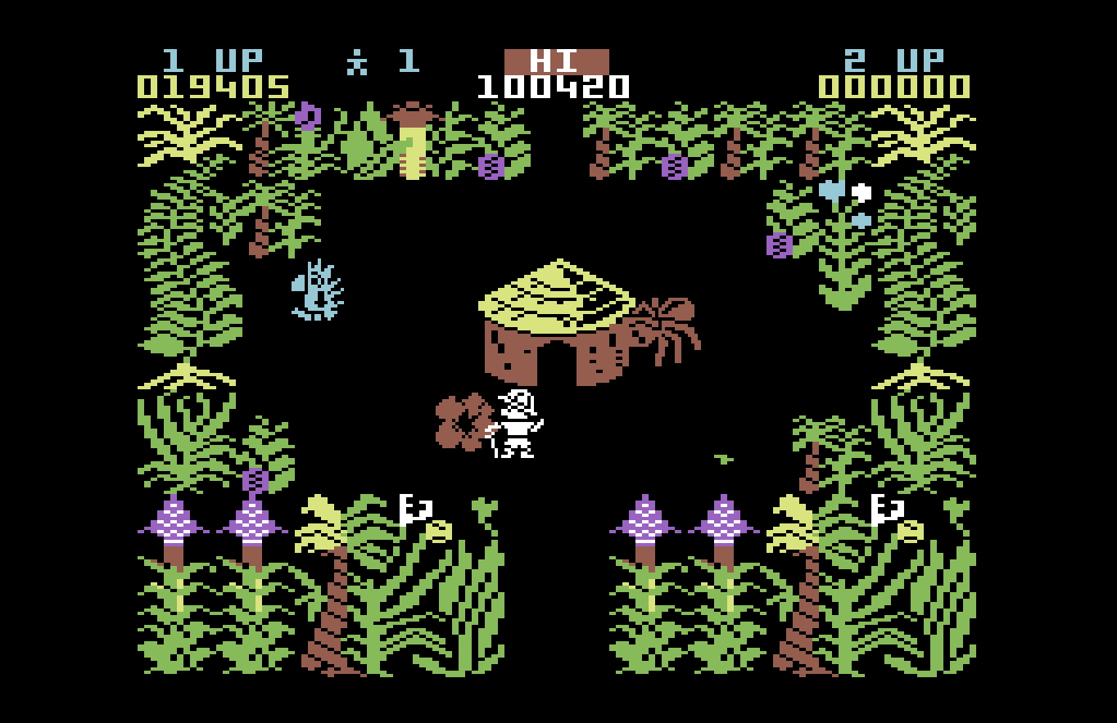
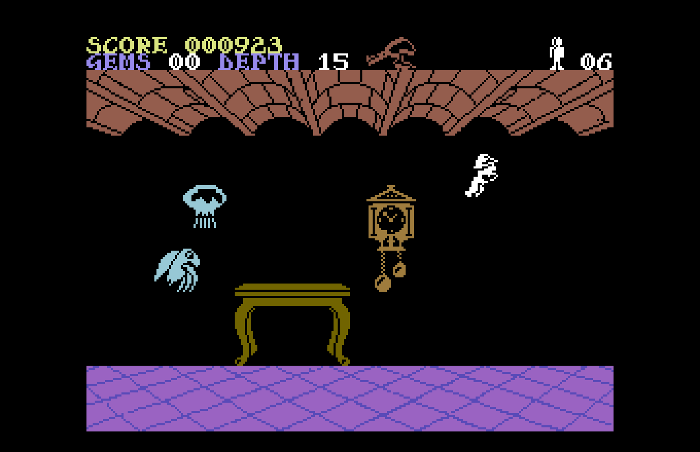

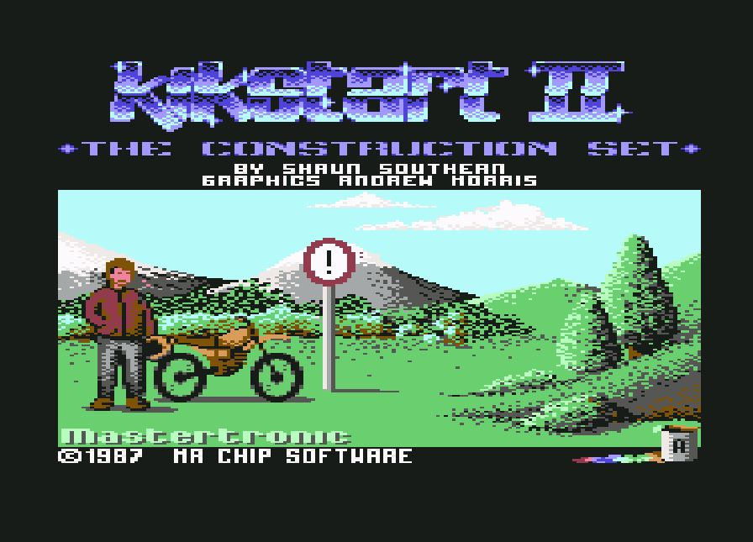
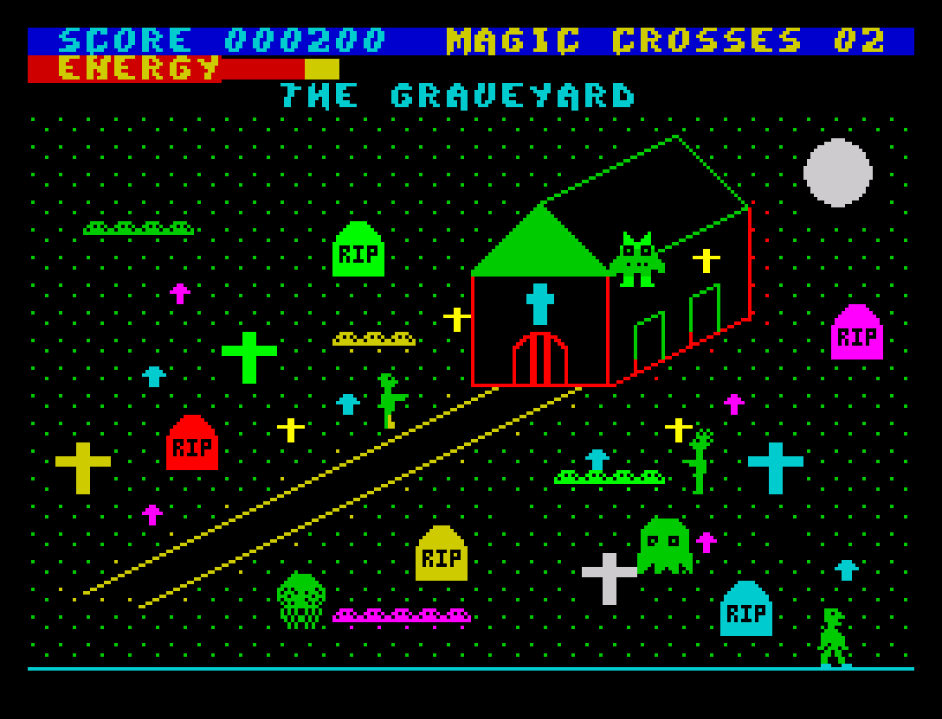
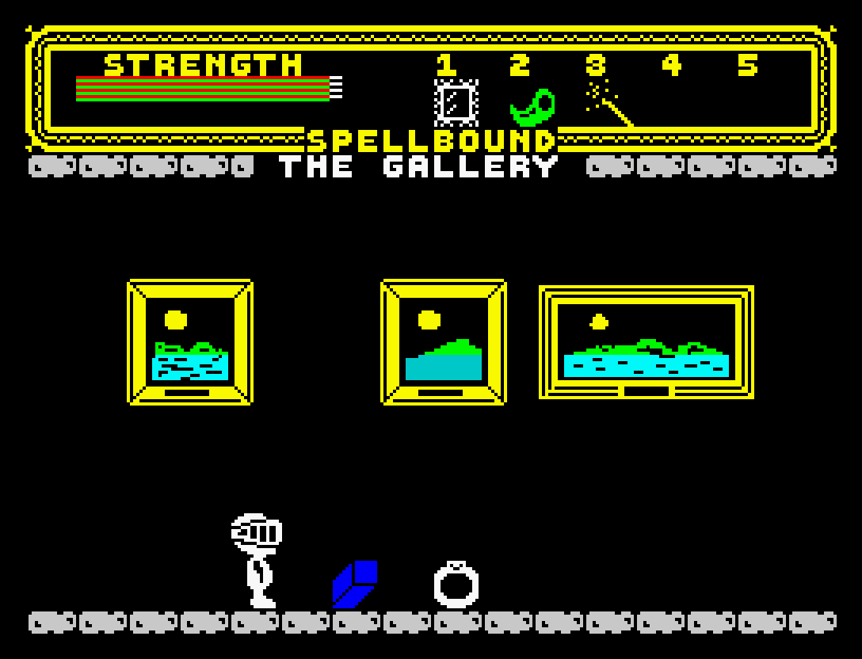



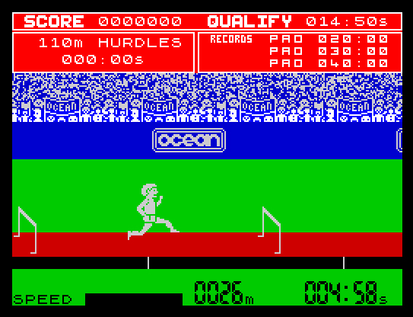
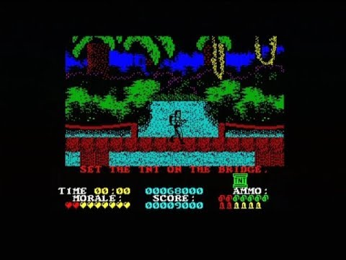
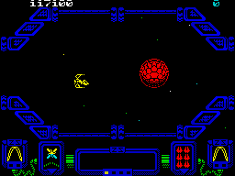
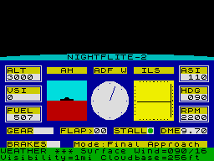

2. A Brief History of the Games Industry Part 1
Some key developers / publishers of this era…
Ultimate - Play The Game
KnightLore (1984)
Sabre Wulf (1984)
Underwurlde (1984)
Mastertronic
Kikstart 2 (1987)
Chiller (1985)
Spellbound (1985)
Ocean
Miami Vice (1986)
Daley Thompson’s Decathalon (1984)
Platoon (1986)
Hewson Consultants
Zynaps(1987)
Nightflite 2 (1987)
Supercup Football (1990)

Slide 16




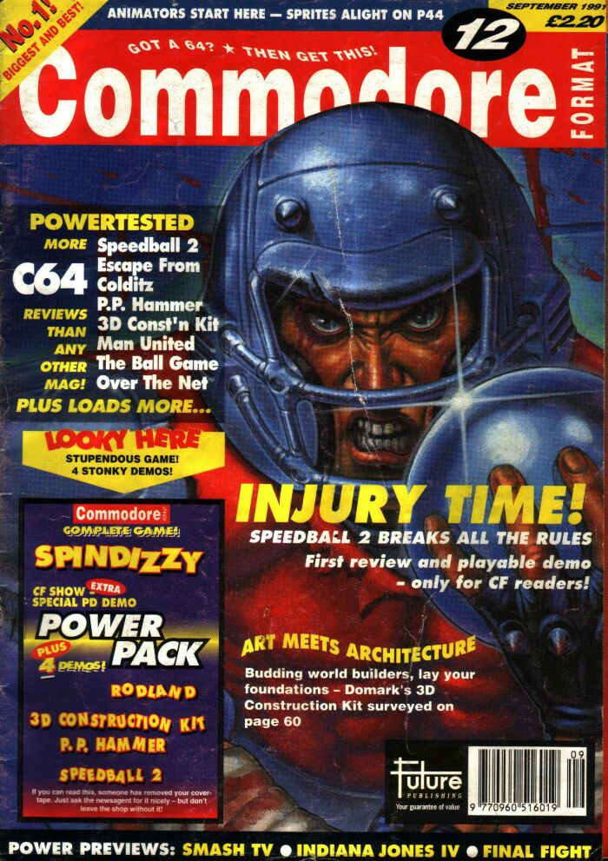
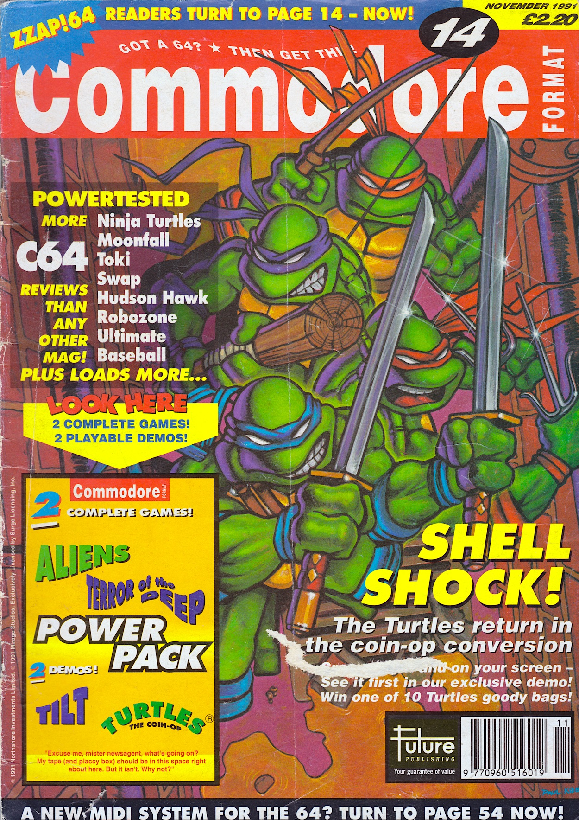

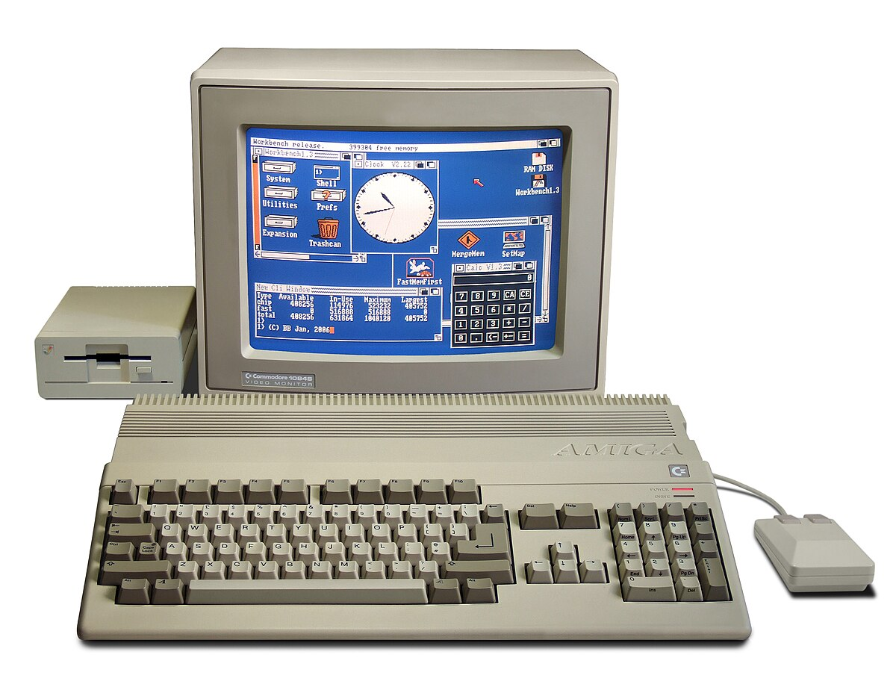
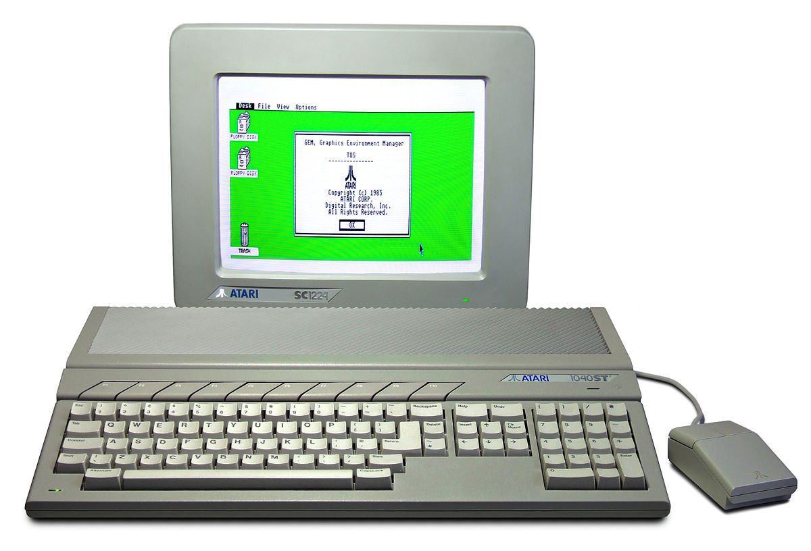
2. A Brief History of the Games Industry Part 1
Video game journalism takes off – Cover mounted cassettes!
Mid to Late 80’s – The arrival of the 16-bit home computers:
Atari ST
Commodore Amiga

Slide 17
3. Developer / Publisher Relations
Developers and publishers play very distinct rolls in the game development life-cycle…
Developer – The team responsible for creating the game (artistic, creative and technical).
Publisher – Manages the financial aspects – Project management, production, direction, marketing, analytics, design, manufacture, and shipping.
What about Independents (Indies)? We arguably have greater access to the tools and mechanisms to get a game to market, thanks to direct-to-market platforms such as Steam, Epic Game Store, Microsoft Store… Indie developers however will often have to take on many roles, which will include funding and marketing the game as well as creating it.
This is an interview with Nick Pearce, indie developer of ‘The Forgotten City’, a game that originally started life as a mod for Skyrim. - https://youtu.be/QbhZSOZgLTs?si=XMilTCq5Uo1isx_p

Slide 18






3. Developer / Publisher Relations
Developers can be in-house (EA), or independent. Microsoft Studios houses a number of subsidiary developer studios…

Slide 19
3. Developer / Publisher Relations
Developers obtain the necessary funds to create the game from the publisher.
This is not a guarantee – First the developer pitches the game idea to the publisher. If the pitch is successful and funding is agreed, a series of milestones are established to guide the development timeline. These may take the form of different builds of the game and will be specific in what is expected. On completion of a milestone, payments (advance on royalties) will be made to fund further development.
For Indie developers, there are other sources of funding available. Ukie publish a list of funding sources, and Epic have their MegaGrant for games and interactive media made with Unreal Engine 5. Phasmophobia developers, Kinetic Games recently announced the launch of Kinetic Studios as a way to support independent game development (Norris, 2026).
The relationship between the developer and the publisher can cause tension. Publishers carry a lot of the financial risk and may wish to monitor the development process very closely, or even push the project in a different direction to the original vision of the developers.
The benefit for the developer can be access to a lucrative IP.

Slide 20




4. Marketing
How do you find out about games that are in development?
Marketing is a necessary, and often frowned upon, part of the product life-cycle. Marketers are adept at their job.
Traditionally, games were marketed through print media – industry / home computer magazines. Media coverage, such as favourable reviews were also beneficial.
Larger publishers could also leverage broadcast media. https://youtu.be/dTJ1Xf_EItA?si=cQieQ8r5o_a-C690
© Copyright Future PLC
© Copyright Newsfield Publications

Slide 21

4. Marketing
Alongside printed and broadcast media, gaming conventions are an important part of the marketing process.
Some important shows:
UK Games Expo (UK)
EGX (UK)
GamesCom (Germany)
Develop (UK)
IndieCade (US)

Slide 22




4. Marketing
Social Media can be a very powerful and effective marketing tool, particularly for solo and small dev teams. They can utilise social media to communicate directly with their potential audience, and to keep the community updated.
The rise of streaming games to an audience, through platforms such as Twitch and YouTube, has created some unique opportunities for marketing games.
Twitch/YouTubers like ‘InSym’ and ‘Maggstor’ have introduced his audience to many indie ghost-hunting and horror games, such as Phasmophobia, Demonologist, Forewarned, Dark Hours…

Slide 23
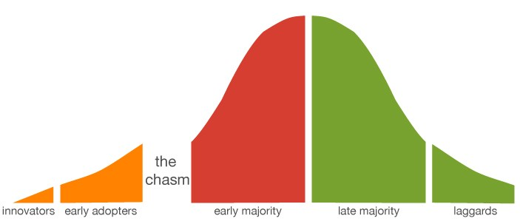
4. Marketing
To market a modern game, it is important to understand two important aspects:
The timing of updates and feature releases to maximise the product’s life-cycle
Analytics to better understand your players and how they engage with the game
• Geoffrey Moore’s “chasm” represents the challenge start-ups must face when migrating a product to the masses. To overcome this…
Typical product life-cycle…
Early access, limited time trials
Create the “whole product” – don’t try to sell to the majority without being feature complete.
2. Market the product appropriately for “sceptical pragmatists” who make up the early majority
3. Price the product relative to competitive comparisons rather than using value-based pricing (value as perceived by the customer)
4. Distribute the product through the right channels
http://www.theinnovativemanager.com

Slide 24
4. Marketing
For games, particularly mobile, the shelf-life can be very short.
In order to maximise investment, understanding where the game is in the product life-cycle is important as it allows the timing of new features / updates to re-generate interest in the game, increasing its shelf-life.
http://www.theinnovativemanager.com

Slide 25


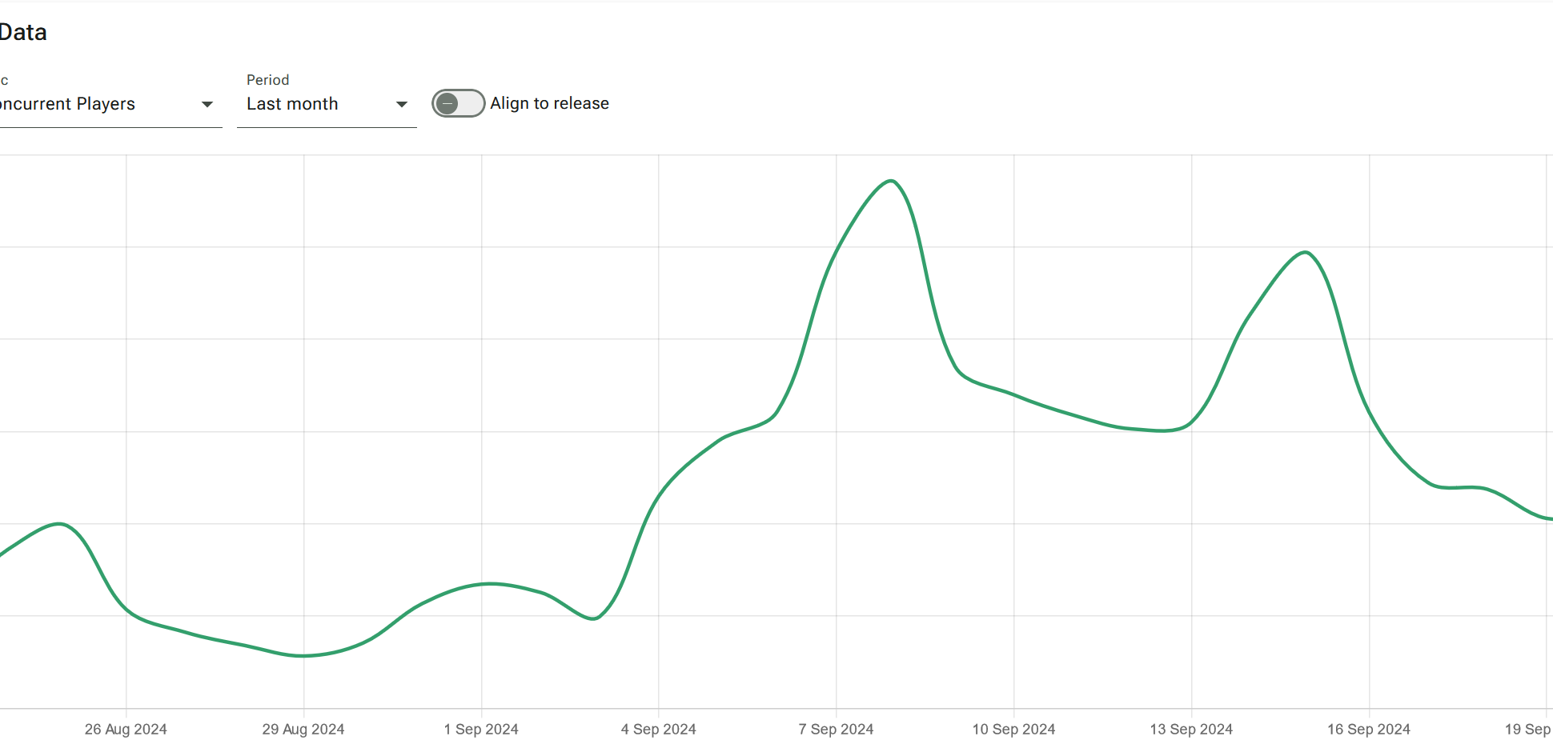
4. Marketing
We can see this in action with games such as No Man’s Sky by Hello Games.
No Man’s Sky has been supported since its release with free updates and DLC.
The updates can cause an upswing in sales and also lure lapsed players back to the game.
No Man’s Sky utilises Expeditions, which are time-limited events where players can earn new items and cosmetics for completing a series of quests.
These Expeditions also are streamed on Twitch for rewards.
Source: https://vginsights.com/game/no-man-s-sky

Slide 26
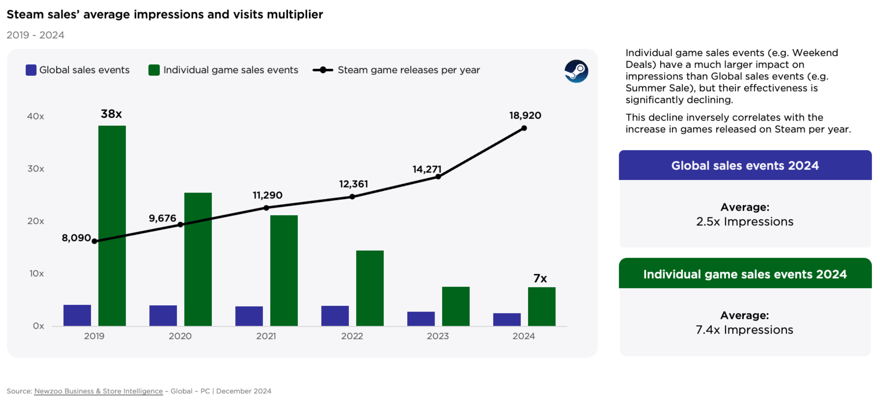
Running out of Steam?
Data from between 2019 and 2024 indicates that Steam’s internal promotional mechanisms, which they have historically used to drive interest and sales, no longer have the same drawing power for gamers.
According to Newzoo (2025) 46% of traffic for Steam games now comes from external sources – Content creators, social media…

Slide 27
4. Marketing
Analytics are important as they can guide game design. For mobile and F2P games, understanding your player-base is crucial for monetisation and generating revenue.
Three primary areas of data collection are:
The User (Player / Customer): How does the player interact with the game (where do they go? What do they do?), their performance, interactions with other users.
Performance: Technical information relating to the game’s performance, such as FPS, server load, latency, hardware considerations such as GPU)
Process: For the publisher and developer – Monitoring task size / allocation, sprints (depending on the methodology employed)

Slide 28
References
Britannica, (2024) Pong: electronic game. [Online] Available at: https://www.britannica.com/topic/Pong [Accessed 21 September 2024]
Carpenter, N. (2019) Epic Games suing Fortnite tester who leaked Chapter 2 [Online] Available at: https://www.polygon.com/fortnite/2019/10/25/20932658/epic-games-fortnite-lawsuit-chapter-2-leak [Accessed 22 September 2024]
Clement, J. (2024) Consumer spending on boxed software video games in the United Kingdom (UK) from 2013 to 2023 [Online]. Available at: https://www.statista.com/statistics/513292/consumer-spending-on-boxed-software-united-kingdom-uk/ [Accessed 21 September 2024]
Dalakov, G (N.D.) Goldsmith and Mann [Online]. Available at: http://www.computer-timeline.com/timeline/goldsmith-and-mann/ [Accessed 21 September 2024]
McEvoy, S. (2024) TIGA: UK games studios “cautiously optimistic” about the industry in 2024 [Online]. Available at: https://www.gamesindustry.biz/tiga-uk-games-studios-cautiously-optimistic-about-the-industry-in-2024 [Accessed 18th September 2024]
Newzoo (2025) ‘2025 Global Games Market Report’, Newzoo (Accessed 13 January 2026).
Norris, R (2026) Phasmophobia developer announces new indie publishing label: 'We’re now in the place where we want to support studios…and provide the support I'd have appreciated at the start of my journey’ [Online] Available at: https://www.pcgamer.com/games/phasmophobia-developer-announces-new-indie-publishing-label-were-now-in-the-place-where-we-want-to-support-studios-and-provide-the-support-id-have-appreciated-at-the-start-of-my-journey/ [Accessed 14th January 2026]
Stilphen, S. (N.D.) The Atari Compendium: The Great Market Crash [Online] Available at: https://www.ataricompendium.com/archives/articles/crash/crash.html [Accessed 18th September 2024]
Ukie (2024) 2023 Video Game Industry Valuation [Online]. Available at: https://ukie.org.uk/news/2024/04/2023VideoGameIndustryValuation [Accessed 18th September 2024]
Wardrip-Fruin, N. (2021) Before Pong, There Was Computer Space [Online]. Available at: https://thereader.mitpress.mit.edu/before-pong-there-was-computer-space/ [Accessed 21 September 2024]

